Slide 1
FPGA Alarm Clock Implemented using Verilog
By: Kyle Acosta, Jeff Tang, Jimmy Luu, and Rob Ranit

Slide 2
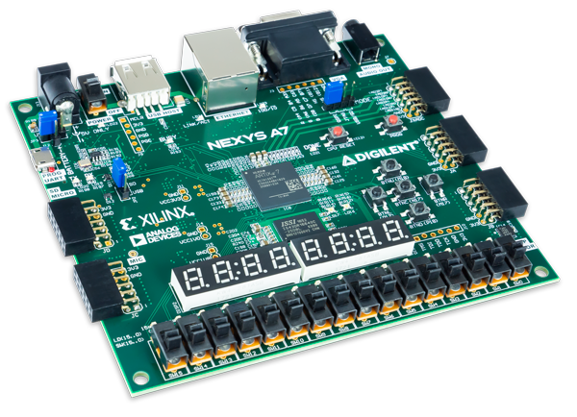
Nexys A7-100T
Artix-7 Field Programmable Gate Array (FPGA)
Programmed with Verilog code
Logic designed in Xilinx Vivado ML 2023.1

Slide 3
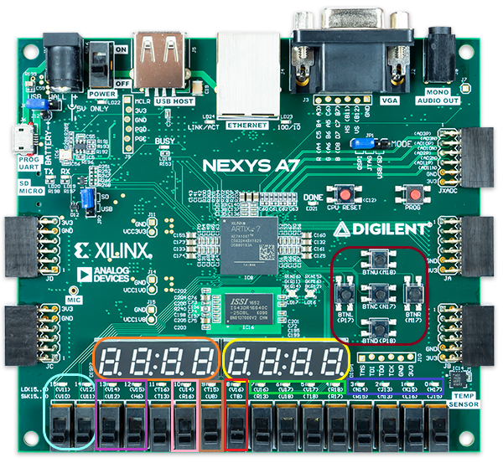
Inputs/Outputs on FPGA
Orange
AN[7:4] - clock time
Yellow
AN[3:0] - alarm
Light Blue
SW[15] - clock enable
SW[14] - clock load
Purple
SW[13] - alarm enable
SW[12] - alarm load
Pink
SW[10] - LED enable/disable
Brown
SW[9] - minute reset
Red
SW[8] - complete reset

Slide 4
Inputs/Outputs on FPGA
Green
LED[7:4] - digit load position
Indigo
LED[3:0] - load value in binary
Dark Red
BTNU/BTND - load value increasing/decreasing
BTNL/BTNR - load position left/right
BTNC - reset load value
Neon Green
LD17 - Alarm Enable RGB LED
LD16 - Alarm Match RGB LED

Slide 5
24-Hour Clock

Slide 6
Up-Counter with Load
// up counter bcd w/ load
module ucb
#(parameter MAX = 9)
(
input clk,
input rst,
input en,
input load_en,
input [3:0] load_num,
output reg [3:0] out,
output flag
);
// up counter bcd 0 -> 9 logic
always@(posedge clk or posedge rst)
begin
if(rst)
out <= 0;
else if(en)
begin
if(load_en)
out <= (load_num > MAX) ? MAX : load_num;
else
out <= (out >= MAX) ? 0 : out + 1;
end
end
// flag logic
assign flag = (out >= MAX) ? 1 : 0;
endmodule
Parameterized
Allowing to use of the same module for different digits
Load
Both en & load_en are active
out is set to load_num, unless greater than the max
Incrementing
en high, out increases by 1 every clk cycle
out equal to MAX, the next clk reset to 0
Flag
Set to 1, while out equal to MAX
Otherwise 0

Slide 7
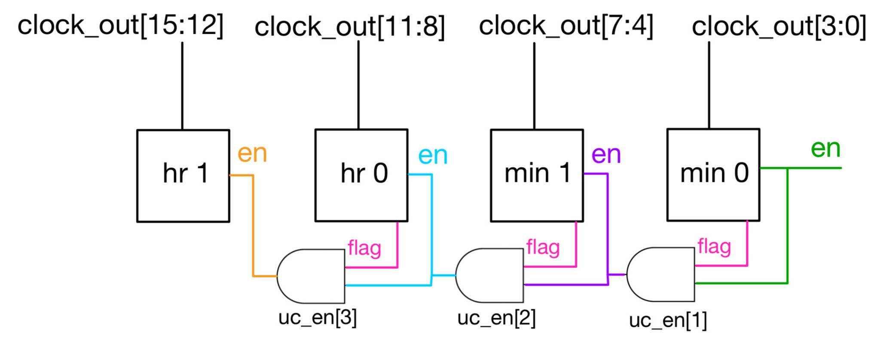
Clock Digits using Up-Counters
For a later digit to increase, the previous counters’ flags must be high
For hr 1, hr 0, min 1, the enable is the previous flag and the clock enable
The outputs of the counters are in a 16-bit wire, to display on the 7-segment displays

Slide 8
Counter Maximum
// HR_1 up counter 0 -> 2
ucb
#(.MAX(2))
C_HR1(
.clk(clock_clk_cond),
.rst(rst || rst_24hr),
.en(uc_en[3] || load_LR[7]),
.load_en(load_LR[7]),
.load_num(load_val),
.out(clock_out[15:12]),
.flag(flag_tmp[3])
);
hr 1 - 0 to 2
hr 0 - 0 to 9
min 1 - 0 to 5
min 0 - 0 to 9
This allows for the complete 24-hour clock range
00:00 to 23:59
Minute after 23:59, returns to 00:00

Slide 9
24-Hour Reset
Additional reset condition
Occurs every minute, checks if the conditions are met
Clock enable
hr 0 is equal to 3
hr 1, min 1, min 0 flags are high
If all conditions are met, reset all counters
Otherwise, do nothing
When a value greater than 23:59 is loaded
And clock_load is low, all counters are reset to 0
// RST FOR 23:59
/*--------------------------------------------------------------------*/
reg rst_24hr;
wire rst_24hr_cond;
assign rst_24hr_cond = (((en || clock_load == 0) && (clock_out[11:8] > 3) && flag_tmp[3]) || clock_load) ? clk : min;
always@(posedge rst_24hr_cond)
rst_24hr <= ((en && (clock_out[11:8] >= 3) && (flag_tmp[1:0] == 2'b11) && flag_tmp[3]) || ((clock_load == 0) && (clock_out[11:8] > 3) && flag_tmp[3])) ? 1 : 0;

Slide 10
Load Left/Right
reg [2:0] cnt_tmp;
always@(posedge clk)
begin
if(rst)
cnt_tmp <= 0;
else
begin
if(clock_load_en && (cnt_tmp < 4 || cnt_tmp > 7))
cnt_tmp <= 4;
else if(alarm_load_en && (cnt_tmp < 0 || cnt_tmp > 3))
cnt_tmp <= 0;
else
begin
if(left)
cnt_tmp <= cnt_tmp + 1;
else if(right)
cnt_tmp <= cnt_tmp - 1;
end
end
end
Left button
Adds 1 to the temporary register
Right button
Subtracts 1 from the register
Range of clock load
4 to 7
Range of alarm load
0 to 3

Slide 11
Load Left/Right
always@(cnt_tmp)
begin
if(clock_load_en || alarm_load_en)
begin
case(cnt_tmp)
3'd0: out <= 8'b00000001;
3'd1: out <= 8'b00000010;
3'd2: out <= 8'b00000100;
3'd3: out <= 8'b00001000;
3'd4: out <= 8'b00010000;
3'd5: out <= 8'b00100000;
3'd6: out <= 8'b01000000;
3'd7: out <= 8'b10000000;
default: out <= 8'd0;
endcase
led <= clock_load_en ? out[7:4] : out[3:0];
end
else
out <= 0;
end
Based on the register, the 8-bit output only has one of the bits high
Each of the up-counters is assigned 1 out of the 8 bits
Only 1 counter has the load enabled
LED position assigned depending on whether the clock load is active

Slide 12
Load Up/Down
module load_ud
#(parameter MAX = 9)
(
input clk,
input rst,
input up,
input down,
output reg [3:0] out
);
always@(posedge clk)
begin
if(rst)
out <= 0;
else
begin
if(up)
out <= (out >= MAX) ? 0 : out + 1;
else if(down)
out <= (out <= 0) ? MAX : out - 1;
end
end
endmodule
Up button
Adds 1 to register
Set to 0 after 9
Down button
Subtracts 1 from register
Set to 9 less than 0
Center button
Resets this register
Load the up-counter with a value

Slide 13
LEDs
Each input has a corresponding LED
clock_en - LED[15]
clock_load - LED[14]
alarm_en - LED[13]
alarm_load - LED[12]
minute_rst - LED[9]
rst - LED[8]
LED Enable/Disable
LED[10] = on
All LEDs active
SW[10]
Active low, flip up to disable all LEDs
LED[7:4]
Position of clock/alarm load
LED[7] = hr 1; LED[4] = min 0
LED[3:0]
Binary of load_ud
Represents the number that is loaded into a counter

Slide 14
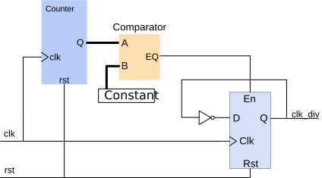
Clock Divider
Digilent Verilog example
Uses a counter, comparator, and flip flop
Output is a 1 Hz clock signal
The References slide contains the link to the example

Slide 15
Timing (Load)
wire clk_load;
// clk for load
clk_div
#(.SIZE(25000000))
CLK_LOAD(
.clk(clk),
.clk_div(clk_load) // 0.5 sec
);
Edited from Digilent example
load_LR & load_ud uses a 2 Hz clock signal
2 Hz corresponds to 0.5 seconds
Users can either briefly press or hold the button
Press - increment/decrement by 1
Hold - continuously increase/decrease
Ideal amount of time
Not much delay when a button is pressed
Operators can easily set a desired value without numbers changing too quickly

Slide 16
Timing (Minute)
module min(
input clk,
input rst,
input en,
output reg [5:0] count, // for simulation
output reg out
);
always@(posedge clk)
begin
if(rst)
begin
count <= 0;
out <= 0;
end
else if(en)
count <= (count >= 59) ? 0 : count + 1;
out <= (count >= 59) ? 1 : 0;
end
endmodule
Minute counter range
0 to 59
Increments the count register every 1 second
Count is equal to 59
out signal becomes 1

Slide 17
Timing (Minute)
// 1 Hz clock
clk_div
#(.SIZE(50000000))
CLK_1Hz(
.clk(clk),
.clk_div(clk_1Hz) // 1 sec
);
// minute counter
min CLK_MIN(
.clk(clk_1Hz),
.rst(rst || min_rst || clock_load),
.en(en && (clock_load == 0)),
.out(min) // 60 sec
);
Minute counter is reset depending on:
Full reset
Minute reset
Clock load
Minute begins counting:
Enable is active
clock_load is low

Slide 18
Timing (Counters)
// up counter clk conditional
wire clock_clk_cond;
assign clock_clk_cond = (clock_load && (en == 0)) ? clk : min;
// MIN_0 up counter 0 -> 9
ucb
#(.MAX(9))
C_MIN0(
.clk(clock_clk_cond),
.rst(rst || rst_24hr),
.en(en || load_LR[4]),
.load_en(load_LR[4]),
.load_num(load_val),
.out(clock_out[3:0]),
.flag(flag_tmp[0])
);
// alarm load clk conditional
wire alarm_clk_cond;
assign alarm_clk_cond = alarm_load ? clk : min;
// MIN_0 LOAD
ucb
#(.MAX(9))
A_MIN0(
.clk(alarm_clk_cond),
.rst(rst),
.en(load_LR[0]),
.load_en(load_LR[0]),
.load_num(load_val),
.out(alarm_out[3:0])
);
Counter load conditional
While clock_load/alarm_load is active
Use system clock of 100 MHz
Else
Use minute signal
Reasoning
Loading values use faster clock for low latency
Clock counters use minute signal so all changes are synchronized
Alarm counters are on different clock while clock counters are loaded to prevent any changes when load_LR is shifting
24-Hour Reset
If clock is in the range of 00:00 to 23:59, use minute signal
If clock outside the range, use system clock

Slide 19
Alarm Function

Slide 20
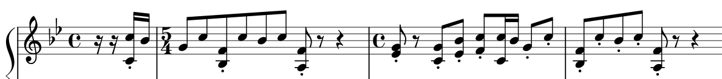
Alarm Sound
Simplified the segment to play on Nexys A7
Doubled the duration of notes
Sixteenth to eighth
Eighth to quarter

Slide 21
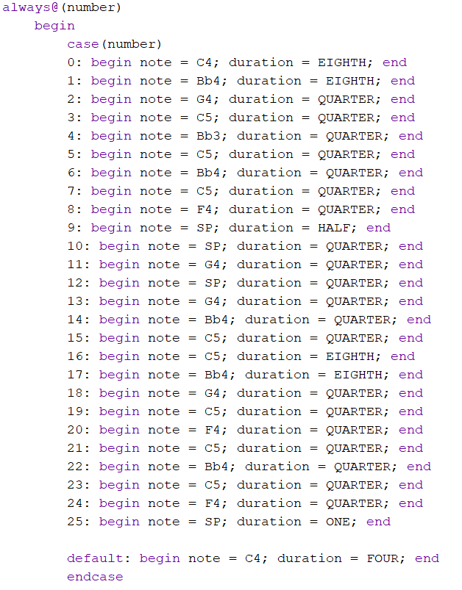
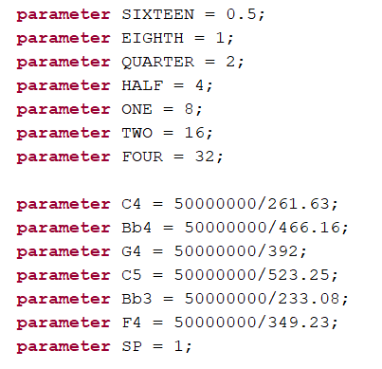
Alarm Sound
Musical notation parameterized to interpret pitch and length
Divided half of clock frequency by note frequency
Number incremented to play alarm sound in order

Slide 22
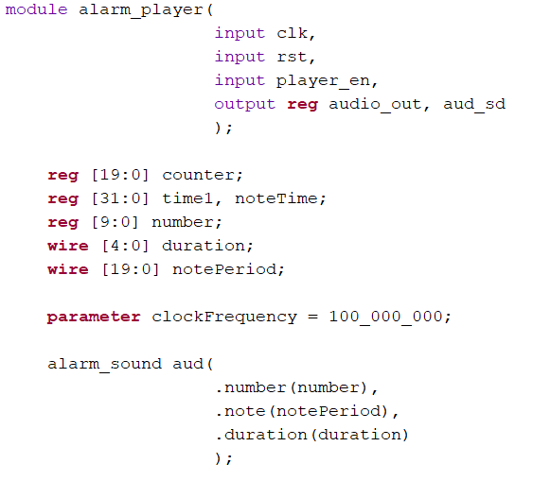
Alarm Player
player_en
Switch input to turn on/off alarm
audio_out
PWM output signal
aud_sd
Audio enable set to HIGH

Slide 23
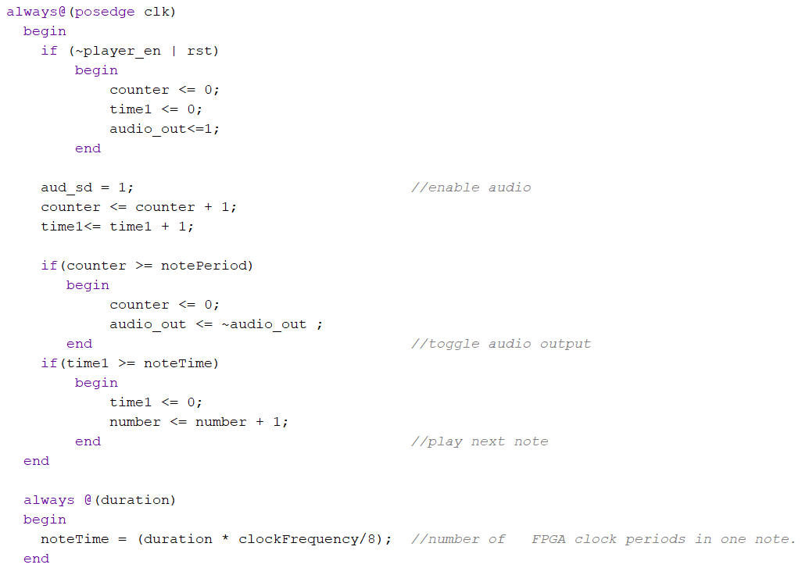
Alarm Player
player_en / rst
Stop incrementing, disable alarm sound
aud_sd
audio enable on D12 pin
counter / time1 increment
Constantly incrementing on positive edge
if counter >= notePeriod
Toggle audio output at note frequency
If time1 >= noteTime
duration of notes
Increments to next note

Slide 24
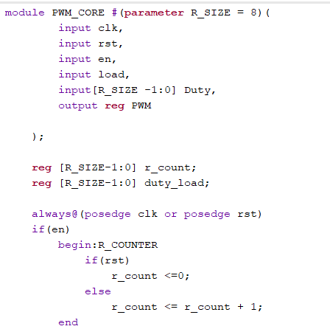
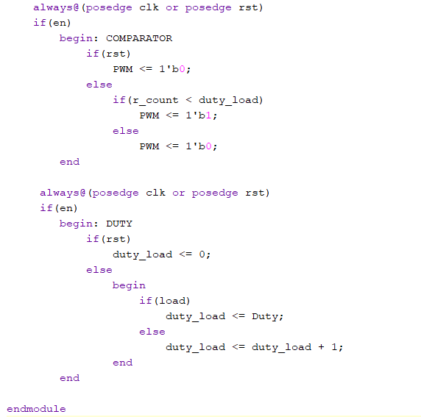
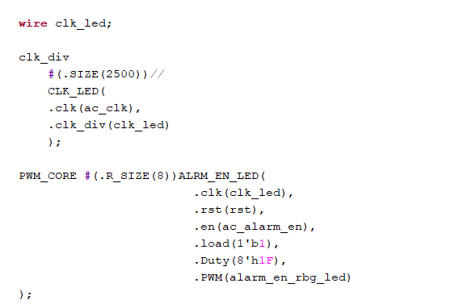
Alarm Enable LED
CLK_LED
high enough frequency clock (ie: 40 KHz) divider to keep the LED illuminated
ALRM_EN_LED - PWM_CORE instantiation to control the rgb LED
en- LED turns on/off based on the top module switch
load - hard coded to 1’b1 so duty cycle is loaded onto the LED
Duty - hard coded to 12.5% duty cycle so LED is not too bright

Slide 25
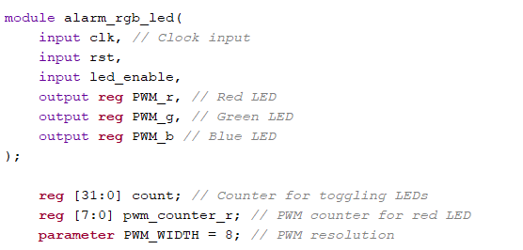
Alarm Match LED
led_enable
Uses enable that turns the alarm player on to also turn the LED on
PWM_r, PWM_g, PWM_b
LED outputs that are assigned to LD16
count
32 bit counter that toggles all LEDs
pwm_counter_r
Red LED PWM 8 bit counter
PWM_WIDTH
PWM Resolution = 8 bits

Slide 26
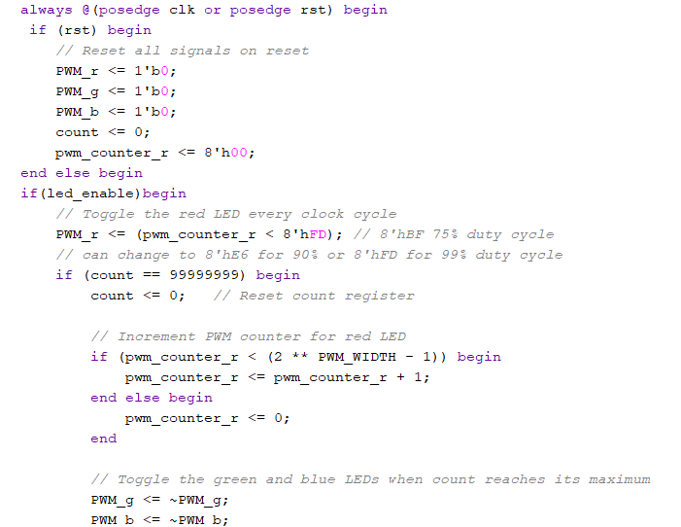
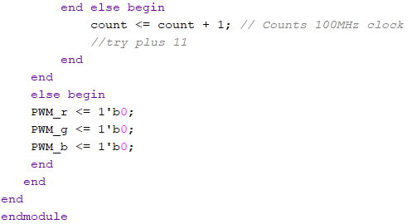
Alarm Match LED
On rst or !led_enable
All LEDs turn off
rst-counters are reset
If led_enable
Red LED gets assigned a duty cycle
With this duty cycle the red LED stays on
Counter increments
PWM counter increments until condition is false
Green and Blue LEDs are toggled
Creates red and white flashing

Slide 27
VGA

Slide 28
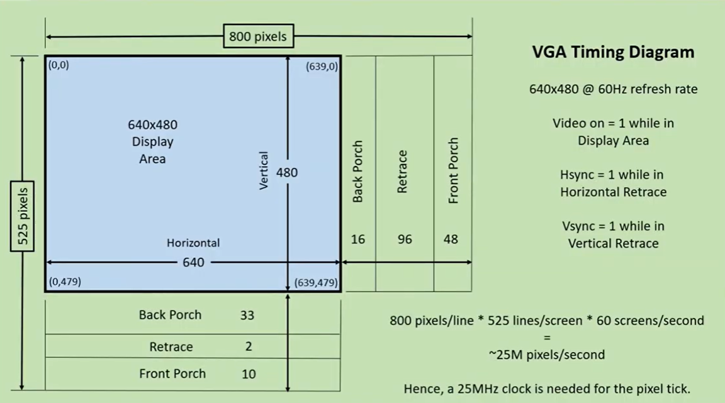
VGA Controller
module vga_controller(
input clk_100MHz, // system clock
input reset, // system reset
output video_on, // ON while pixel counts for x and y and within display area
output hsync, // horizontal sync
output vsync, // vertical sync
output p_tick, // the 25MHz pixel/second rate signal, pixel tick
output [9:0] x, // pixel count/position of pixel x, max 0-799
output [9:0] y // pixel count/position of pixel y, max 0-524
);
clk_100MHz is the system clock, used to divide into 25 MHz later
Reset signal to reset all horizontal and vertical counter values to 0
Outputs are as follows:
Horizontal sync and vertical sync values
25 MHz signal, the signal of the pixel
Pixel count / position of pixel x and pixel y
For a 640 x 480 resolution / display area, using a 60 Hz refresh rate, we’re going to be taking a 800 x 525 pixel area and utilizing a 640 x 480 chunk of it for the actual display area
The rest of the pixels from the 800 x 525 area are used for synchronization
The front and back porch values, along with the retrace values, for a 640 x 480 resolution @ 60 Hz refresh rate are shown in the diagram on the right

Slide 29
VGA Controller: Hsync and Vsync
// Counter Registers, two each for buffering
reg [9:0] h_count_reg, h_count_next;
reg [9:0] v_count_reg, v_count_next;
// Output Buffers
reg v_sync_reg, h_sync_reg;
wire v_sync_next, h_sync_next;
// Register Control
always @(posedge clk_100MHz or posedge reset)
if(reset) begin
v_count_reg <= 0;
h_count_reg <= 0;
v_sync_reg <= 1'b0;
h_sync_reg <= 1'b0;
end
else begin
v_count_reg <= v_count_next;
h_count_reg <= h_count_next;
v_sync_reg <= v_sync_next;
h_sync_reg <= h_sync_next;
end
//Logic for horizontal counter
always @(posedge w_25MHz or posedge reset)
if(reset)
h_count_next = 0;
else
if(h_count_reg == HMAX)
h_count_next = 0;
else
h_count_next = h_count_reg + 1;
Horizontal pixel counters and vertical pixel counters will tick up according to the 25 MHz signal
When the counters are in the retrace areas, the hsync and vsync signals will be set to 1
The horizontal pixel count will also be assigned to the x output in this module
The vertical pixel count will also be assigned to the y output in this module
// Logic for vertical counter
always @(posedge w_25MHz or posedge reset)
if(reset)
v_count_next = 0;
else
if(h_count_reg == HMAX)
if((v_count_reg == VMAX))
v_count_next = 0;
else
v_count_next = v_count_reg + 1;
// h_sync_next asserted within the horizontal retrace area
assign h_sync_next = (h_count_reg >= (HD+HB) && h_count_reg <= (HD+HB+HR-1));
// v_sync_next asserted within the vertical retrace area
assign v_sync_next = (v_count_reg >= (VD+VB) && v_count_reg <= (VD+VB+VR-1));
// Video ON/OFF - only ON while pixel counts are within the display area
assign video_on = (h_count_reg < HD) && (v_count_reg < VD); // 0-639 and 0-479 respectively

Slide 30
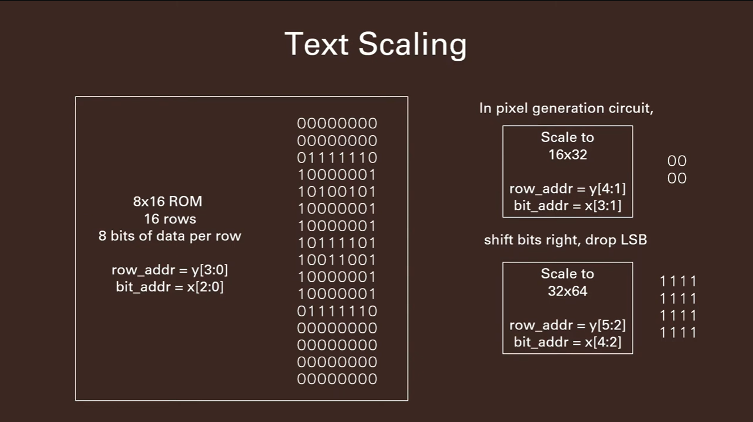
Clock Digit ROM
module clock_digit_rom(
input clk,
input wire [10:0] addr,
output reg [7:0] data
);
(* rom_style = "block" *) // Infer BRAM
reg [10:0] addr_reg;
always @(posedge clk)
addr_reg <= addr;
always @*
case(addr_reg)
// code x30 (0)
11'h300: data = 8'b00000000; //
11'h301: data = 8'b00000000; //
11'h302: data = 8'b00111000; // ***
11'h303: data = 8'b01101100; // ** **
11'h304: data = 8'b11000110; //** **
11'h305: data = 8'b11000110; //** **
11'h306: data = 8'b11000110; //** **
11'h307: data = 8'b11000110; //** **
11'h308: data = 8'b11000110; //** **
11'h309: data = 8'b11000110; //** **
11'h30a: data = 8'b01101100; // ** **
11'h30b: data = 8'b00111000; // ***
11'h30c: data = 8'b00000000; //
11'h30d: data = 8'b00000000; //
11'h30e: data = 8'b00000000; //
11'h30f: data = 8'b00000000; //
Takes in the system clock and the address of the specific clock digit to display concatenated with the pixel values of the y and x coordinates to scale the VGA output to 32 x 64
Utilizes a BRAM to store all of the binary ASCII digits
Each individual bit in the data is scaled up to a 4 x 4 collection of that specific bit, in the case of scaling to 32 x 64, to scale up the pixels in the VGA output

Slide 31
Pixel Generation
module pixel_clk_gen(
input clk,
input video_on,
input alarm_status,
input [9:0] x, y,
input [3:0] min_1s, min_10s,
input [3:0] hr_1s, hr_10s,
input [3:0] alarm_min_1s, alarm_min_10s,
input [3:0] alarm_hr_1s, alarm_hr_10s,
output reg [11:0] time_rgb
);
Inputs
clk: system clock
video_on: flag denoting if horizontal and vertical pixel counters are within range of display area (640 x 480)
alarm_status: flag denoting if clock value is equal to the alarm value
[9:0] x, y: horizontal and vertical pixel counts respectively
[3:0] min_1s, min_10s: minutes ones place and minutes tens place of the clock respectively
[3:0] hr_1s, hr_10s: hours ones place and hours tens place of the clock respectively
[3:0] alarm_min_1s, alarm_min_10s, alarm_hr_1s, alarm_hr_10s: places of alarm clock digits
Outputs
[11:0] time_rgb: color of the pixel at that specific point in time
Displays red whenever pixel is in range of display area for the clock value digits and matches the pattern for the binary ASCII in clock digit ROM
Displays green if the alarm is currently active
Displays black otherwise, black background as well
// *** Constant Declarations ***
// Hour 10s Digit section = 32 x 64
localparam H10_X_L = 224;
localparam H10_X_R = 255;
localparam H10_Y_T = 192;
localparam H10_Y_B = 256;
// Hour 1s Digit section = 32 x 64
localparam H1_X_L = 256;
localparam H1_X_R = 287;
localparam H1_Y_T = 192;
localparam H1_Y_B = 256;
// Colon 1 section = 32 x 64
localparam C1_X_L = 288;
localparam C1_X_R = 319;
localparam C1_Y_T = 192;
localparam C1_Y_B = 256;
// Minute 10s Digit section = 32 x 64
localparam M10_X_L = 320;
localparam M10_X_R = 351;
localparam M10_Y_T = 192;
localparam M10_Y_B = 256;
// Minute 1s Digit section = 32 x 64
localparam M1_X_L = 352;
localparam M1_X_R = 383;
localparam M1_Y_T = 192;
localparam M1_Y_B = 256;

Slide 32
Pixel Generation
(ROM Interface)
// Object Status Signals
wire H10_on, H1_on, C1_on, M10_on, M1_on;
wire A_H10_on, A_H1_on, A_C1_on, A_M10_on, A_M1_on;
// ROM Interface Signals
wire [10:0] rom_addr;
reg [6:0] char_addr; // 3'b011 + BCD value of time component
wire [6:0] char_addr_h10, char_addr_h1, char_addr_m10, char_addr_m1, char_addr_c1;
wire [6:0] char_addr_h10_A, char_addr_h1_A, char_addr_m10_A, char_addr_m1_A, char_addr_c1_A;
reg [3:0] row_addr; // row address of digit
wire [3:0] row_addr_h10, row_addr_h1, row_addr_m10, row_addr_m1, row_addr_c1;
wire [3:0] row_addr_h10_A, row_addr_h1_A, row_addr_m10_A, row_addr_m1_A, row_addr_c1_A;
reg [2:0] bit_addr; // column address of rom data
wire [2:0] bit_addr_h10, bit_addr_h1, bit_addr_m10, bit_addr_m1, bit_addr_c1;
wire [2:0] bit_addr_h10_A, bit_addr_h1_A, bit_addr_m10_A, bit_addr_m1_A, bit_addr_c1_A;
wire [7:0] digit_word; // data from rom
wire digit_bit;
// Example:
assign char_addr_h10 = {3'b011, hr_10s};
assign row_addr_h10 = y[5:2]; // scaling to 32x64
assign bit_addr_h10 = x[4:2]; // scaling to 32x64
Object status signals: these wires are set to 1 when the pixel coordinates are within the pixel regions defined in the previous slide
ROM Interface signals: these signals navigate through the clock digit rom
The character address identifies which digit needs to be displayed and chosen in the ROM (i.e. jump to the binary ASCII representation of 0 if the digit is currently 0)
The row address keeps track of the current row of the ASCII representation of the chosen digit
The bit address keeps track of the current column of the selected row
The digit word is the entire current row of bits
The digit bit is the current bit in the current row of the word
// For clock:
// Hour sections assert signals
assign H10_on = (H10_X_L <= x) && (x <= H10_X_R) &&
(H10_Y_T <= y) && (y <= H10_Y_B) && (hr_10s != 0);

Slide 33
Pixel Generation
(Displaying RGB Pixels)
By default, the pixel at a given point will be black, to show a black background
If the current pixel is within the region of a digit’s pixel area, for example, the hours tens digit of the clock
The specific binary ASCII representation of that digit will be chosen
The row address and column address are scaled to 32 x 64 (the scaling of all digits are 32 x 64 in this project)
If the current bit in the rom ASCII is a 1, the color will be changed from black to either red or green
If the alarm is currently active, the digits will be displayed in green
Else, the digits will be displayed in red
This process essentially draws out each digit of the clock in real time and the background color (black)
// Mux for ROM Addresses and RGB
always @* begin
time_rgb = 12'h222; // black background
if(H10_on) begin
char_addr = char_addr_h10;
row_addr = row_addr_h10;
bit_addr = bit_addr_h10;
if(digit_bit)
if(alarm_status)
time_rgb = 12'h0F0; // green
else
time_rgb = 12'hF00; // red
end

Slide 34
References
https://digilent.com/reference/learn/programmable-logic/tutorials/counter-and-clock-divider/start
https://digilent.com/reference/nexys_vga/refmanual

